Slide 1



University of Texas at Dallas
Should I Read This?
Presented by Brianna Jones

Slide 2
Overview
01
Objective
04
Implementation
02
Literary Preview
05
Result
03
Methodology
06
Conclusion and Final Thoughts

Slide 3
Objective
Develop an Application:
That uses an amalgamation of different machine learning models to accurately predict whether an email is a phishing scam by the text alone.
It can assist elderly people to be more self-sufficient and be scammed less
Deepen my understanding of machine learning
Broaden my understanding of phishing scams and attacks
RQ: Can I deploy such a website/application?
Notes:
Can use this later in my career

Slide 4
Well...Sort Of

Slide 5
Literature Review
The Problem
The elderly are one of the most targeted groups for phishing scams outside of our business markets and organizations
In 2022 alone (ICS, 2023),
~90,000 victims over the age of 60
~$3.1 billion of total losses
Average loss: $35,101

Slide 6
Literature Review
The Solution
Machine Learning is completely capable of detecting phishing scams
An algorithm that clusters similar tokens together aides in increasing the accuracy of malicious token identification (Mazorra, et. al., 2022).
Prioritize by looking at the tokens and extracting key features of the data.
For deep learning classification, the two most accurate models were Decision Trees and Neural Networks (Mugaid, et. al., 2022).
Notes:
of course this comes down to the data, how it is processed, as well as the kind of models you train. But overall it is a well known fact, that you don;t need to go in depth of research to find to be true.
But I did so here it is:

Slide 7
Methodology

Slide 8
Collecting the Data
Public open-source data from GitHub and Kaggle
~30,000 combined URLs and text needed to be sorted and parsed through
For my original project design: separate
2 separate datasets - URLs, Email Text
1,6000 URLs mal and legitimate
400 emails mal and legitimate
For updated project design: combined
200 URLs, both malicious and legitimate
200 emails, both malicious and legit
For preprocessing and training the models: malicious were flagged with “1” and legitimate with “0”

Slide 9
Preprocessing the Data
What I removed:
\n, \t, \”, \r
Extracted URLS to their separate column
What I kept
Distinct punctuation
Spacing
Capitalization
Aggregated the data to show email length and word count
After gathering proper analysis for features to use in my model, the dataset was prepped with one-hot encoding and PCA

Slide 10
Text Analysis
Understanding the key features of what makes an email malicious regarding phishing:
Suspicious: tone, the receiver doesn’t recognize the sender
Spoof sender address
Urgent or threatening language
Requests for Personal Information
Unsolicited attachments or links
Generic greetings: ‘dear customer’
Grammatical errors
Unsolicited offers
Mimicking legitimate brands
Notes:
Based on this generic criteria I knew that the essential key features that needed to be extracted from the data was the sentiment/tone, key topics/words, and grammar

Slide 11
Text Analysis
Word count and email length
Sentiment score,
Fear score
aggression (combined fear and anger)
negative anticipation and positive anticipation
Dominant emotion
Frequency of misspelled words and the ratio of misspelled words by word count

Slide 12
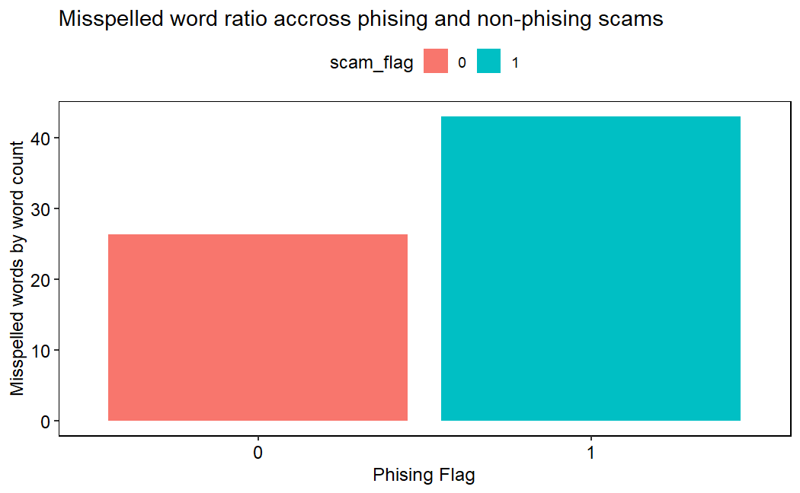

Slide 13
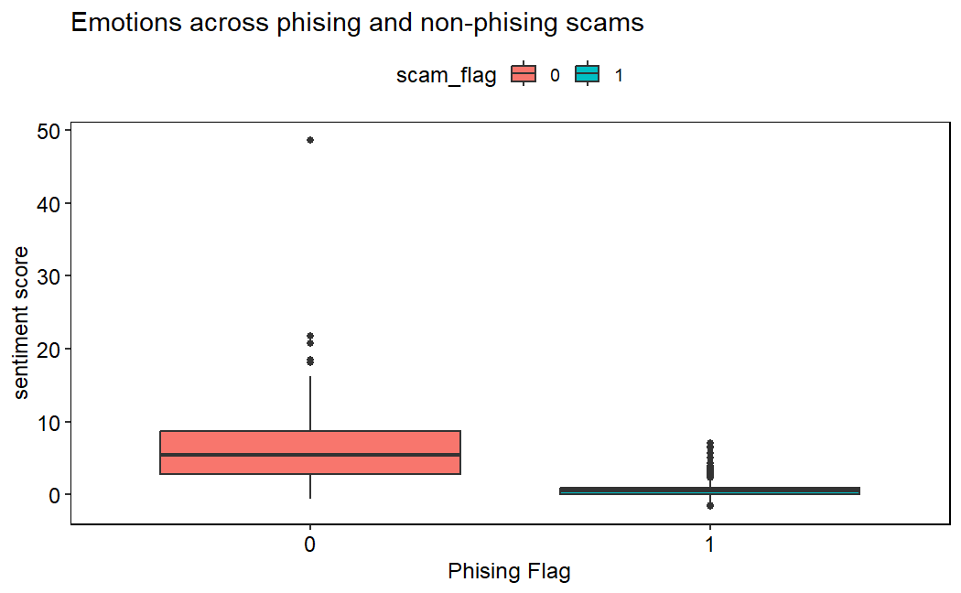

Slide 14
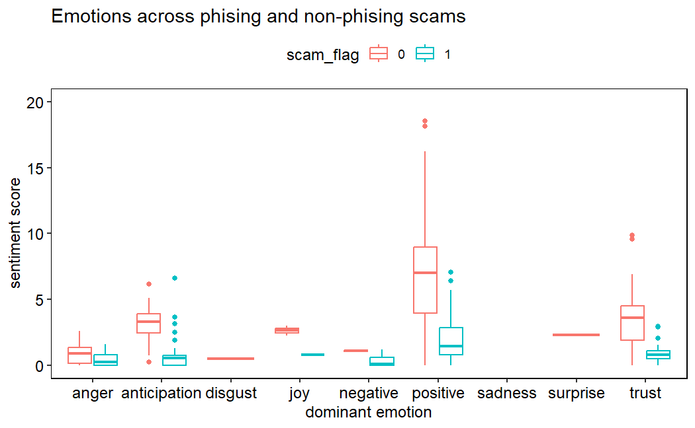

Slide 15
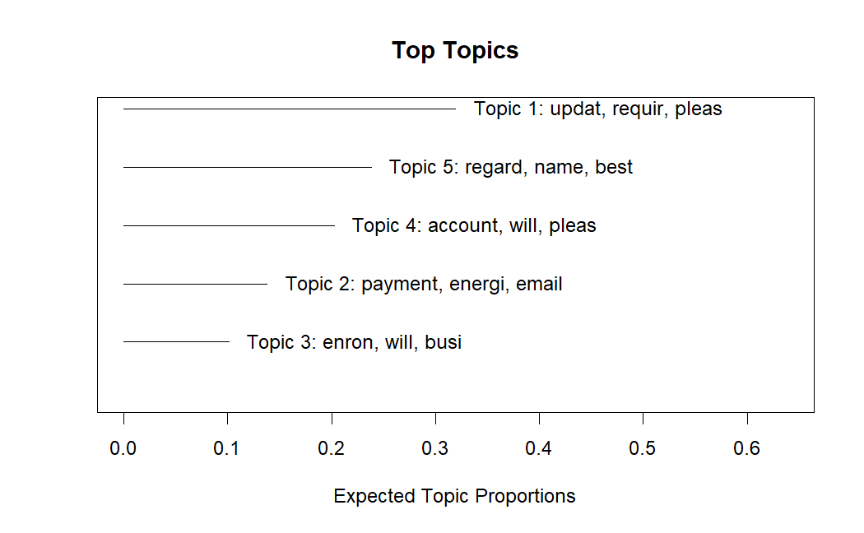
Notes:
Used STM model: show the top topics/keywords across the entire dataset

Slide 16
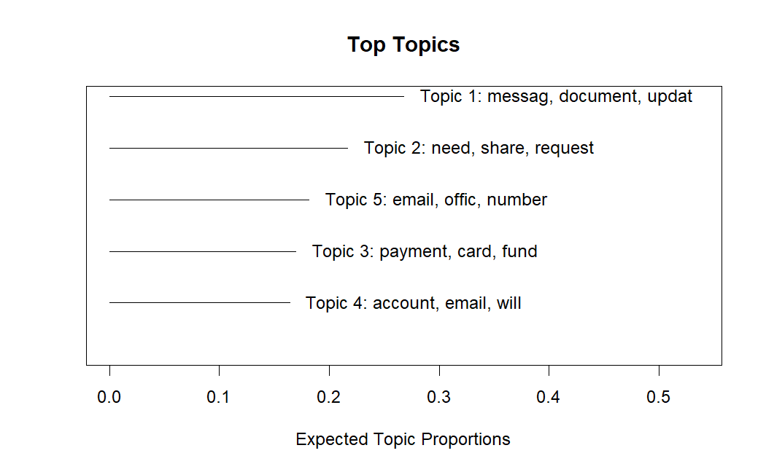
Topics Across Malicious Emails

Slide 17
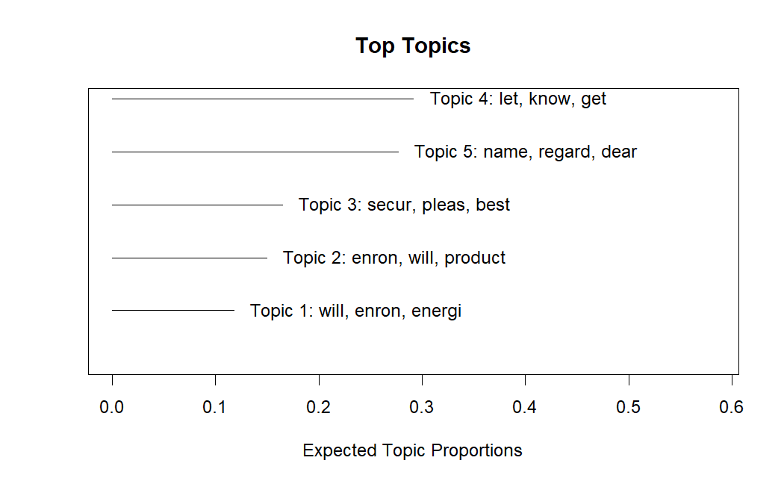
Topics Across Legitimate Emails

Slide 18
Implementation

Slide 19
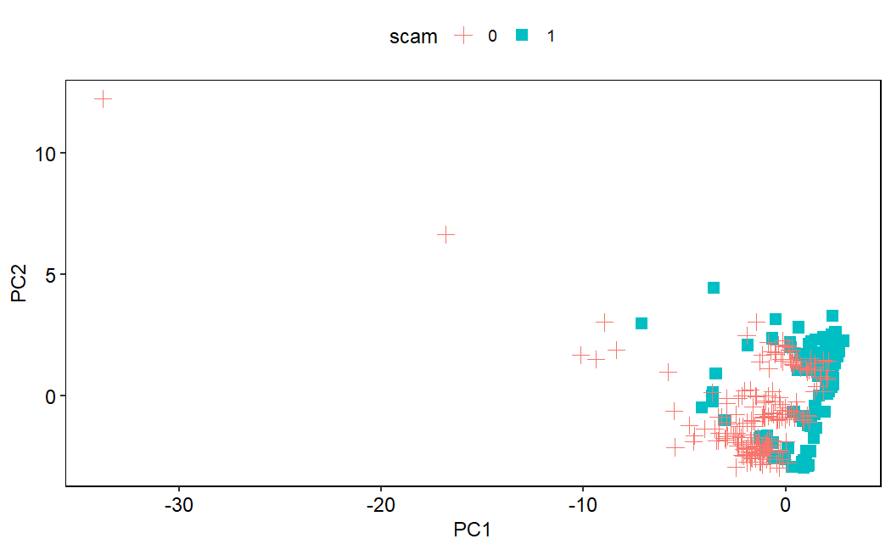
Data Encoded and Compressed

Slide 20
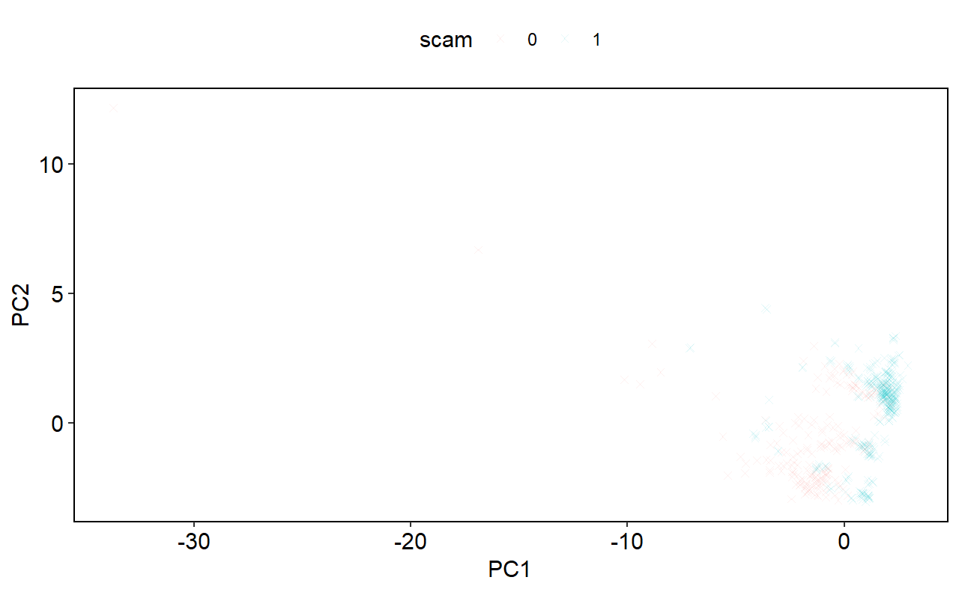
Machine Learning Model: SVM
Notes:
Decided to oversample the malicious email data and use the new dataset for the SVM to create a more distinct boundary

Slide 21
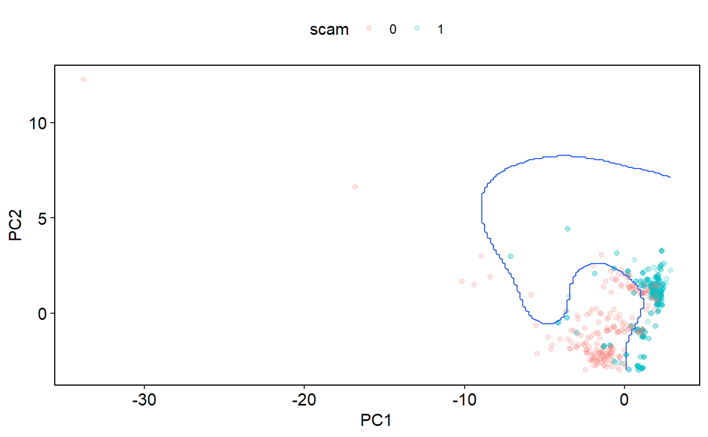
Machine Learning Model: SVM
Notes:
Balanced accuracy of 92.4%, which I was quite satisfied with
Knew the beast I was going to struggle with the most was the NN model, and I was right

Slide 22
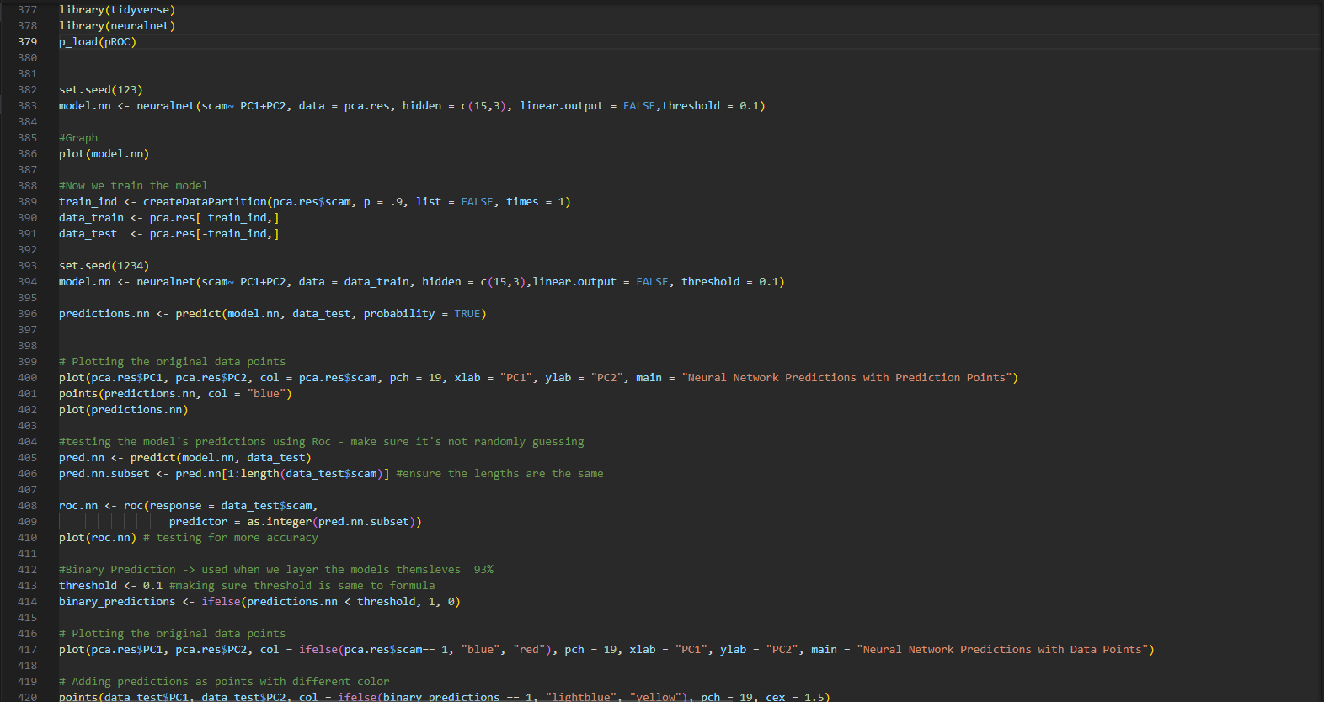
Machine Learning Model: NN
Notes:
The problem child of the bunch that required the most testing, training, evaluating and going back to step one
Tried to use keras and tensor flow (popular neural network) but was battling it out with Rstudio because keras is python and requires r studio to incorporate a separate distinct
Because that was so fussy, I settled to use neuralnet to make my model
The biggest struggle was dealing with the layers, trying to actually plot this in some sort of graph and for it to actually get some sort of boundary

Slide 23
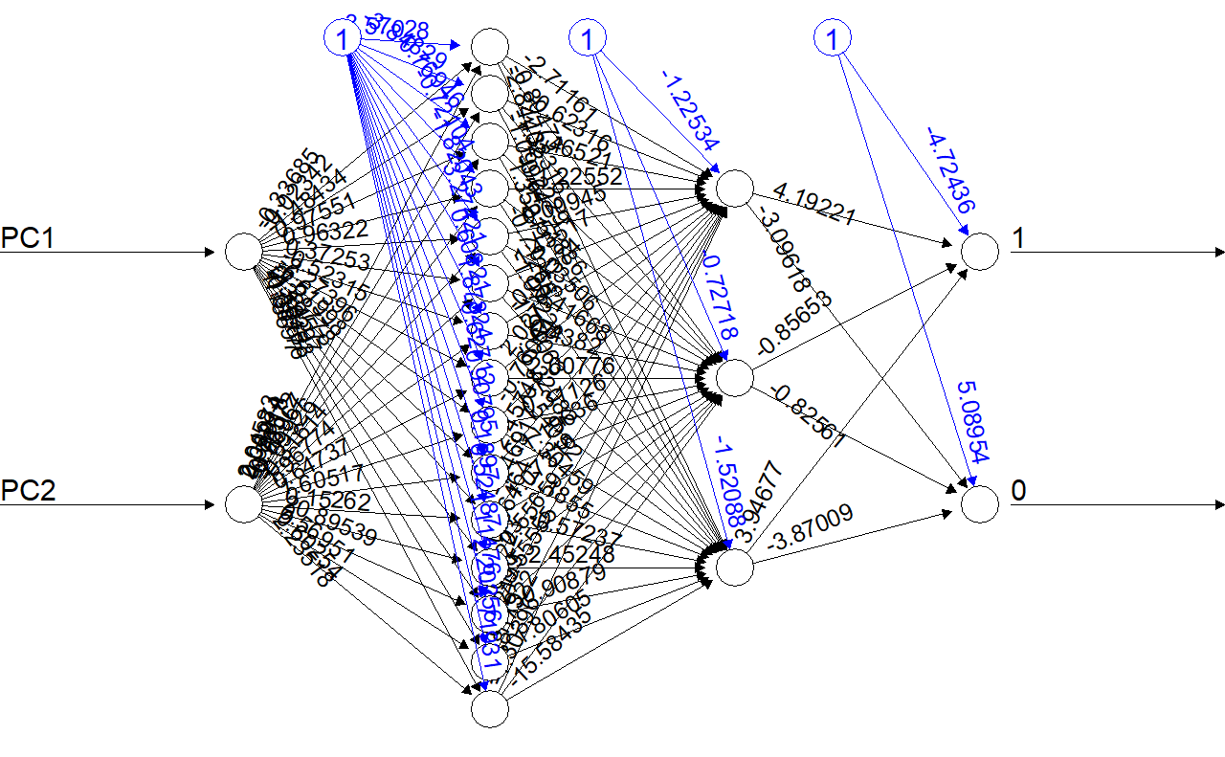
Machine Learning Model: NN

Slide 24
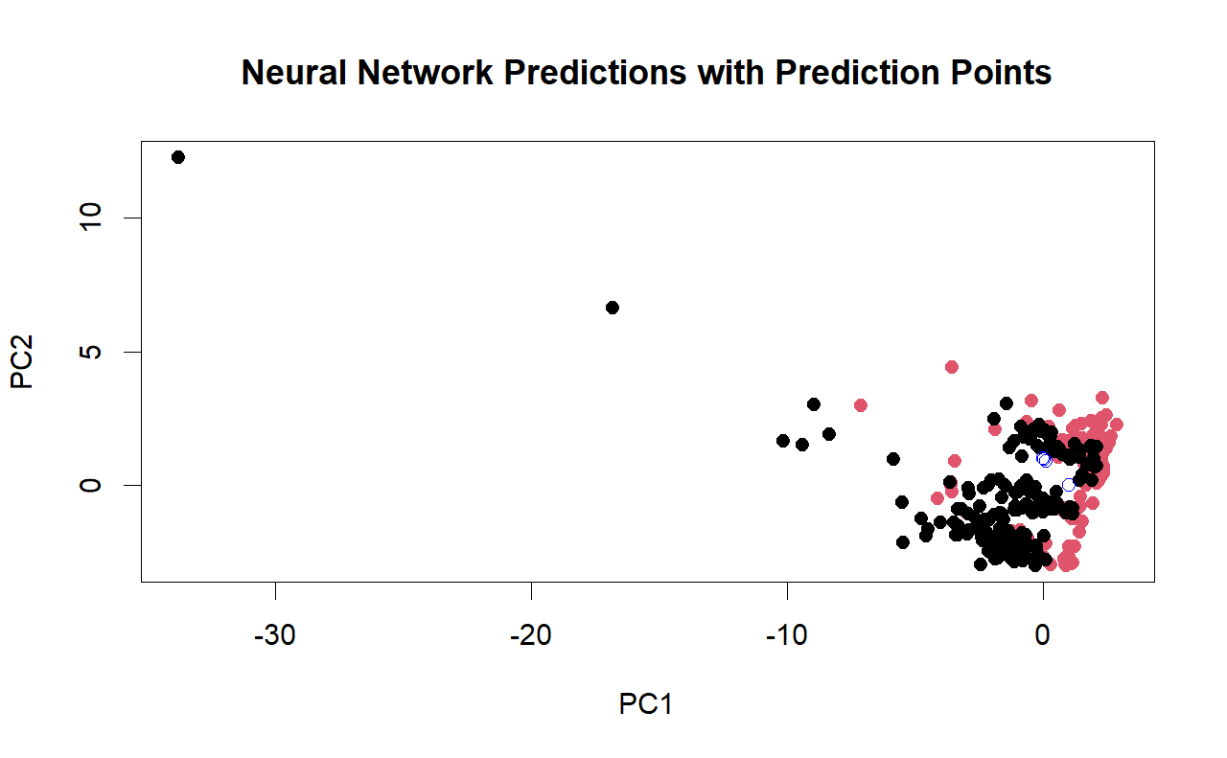
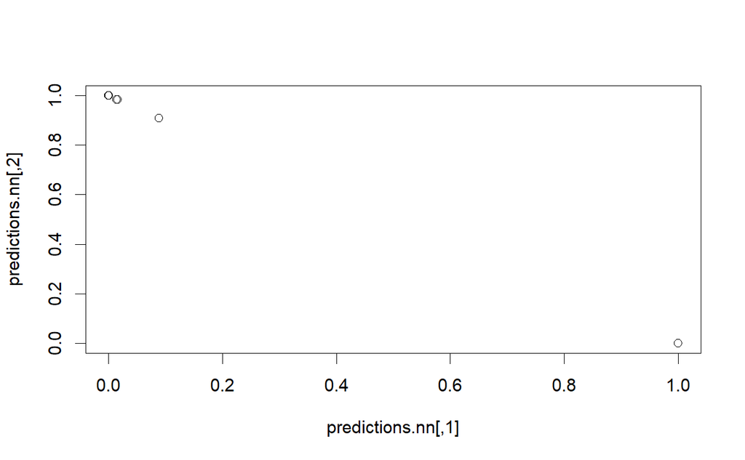
Machine Learning Model: NN

Slide 25
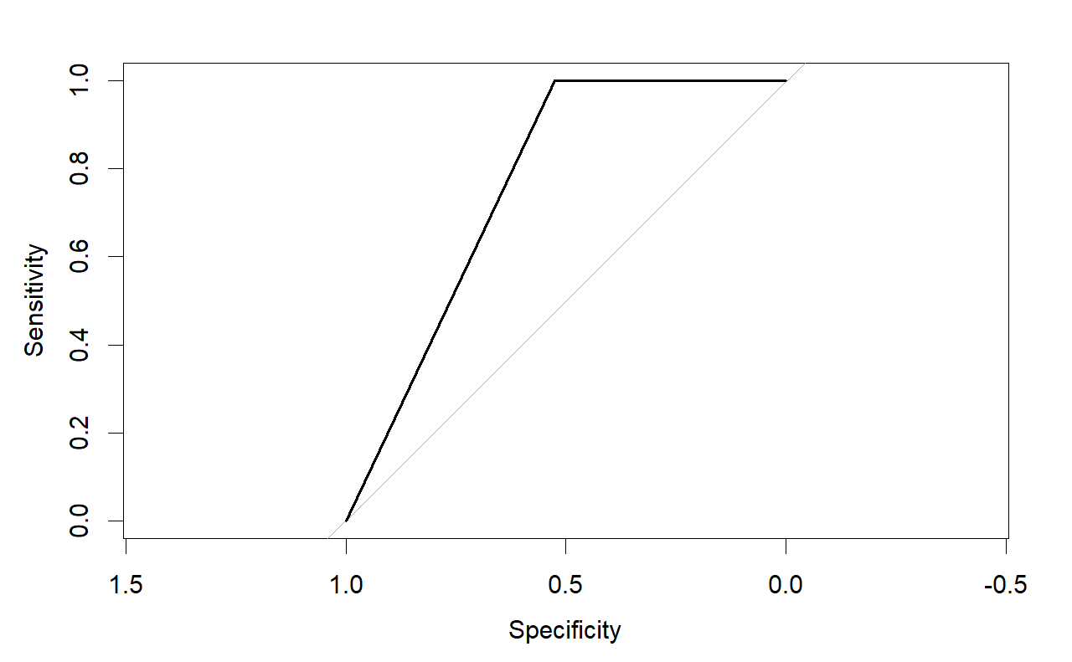
Machine Learning Model: NN

Slide 26
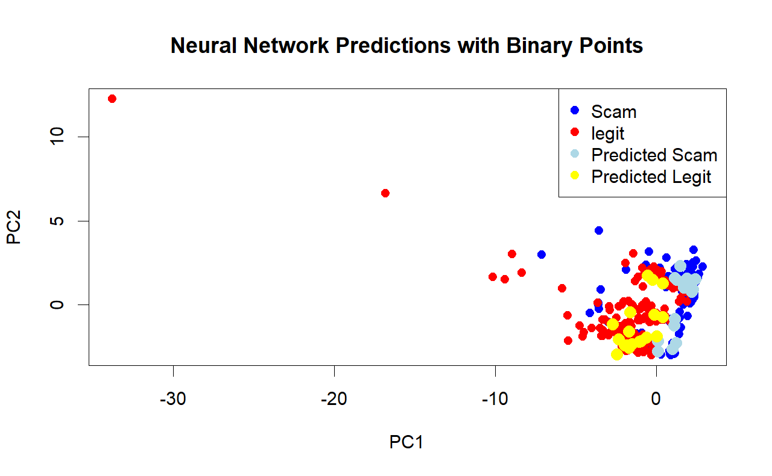
Machine Learning Model: NN

Slide 27
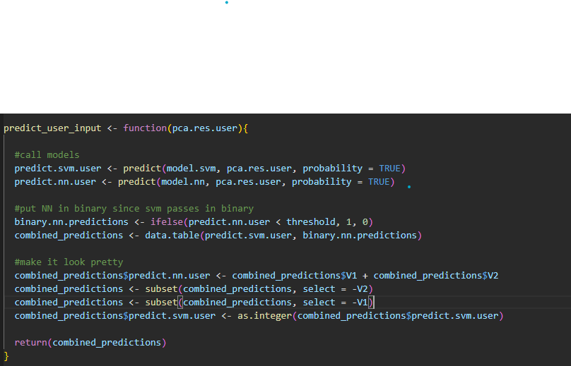
Putting It All Together: Making the Prediction
Notes:
Code from the backend/making sure the functions can work together

Slide 28
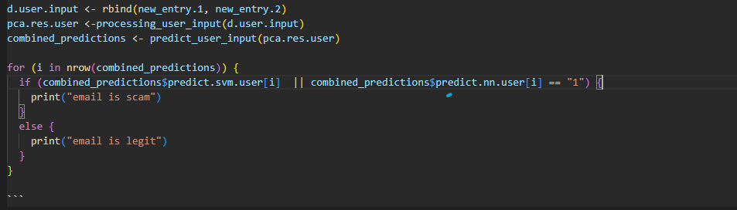
Putting It All Together: Making the Prediction

Slide 29
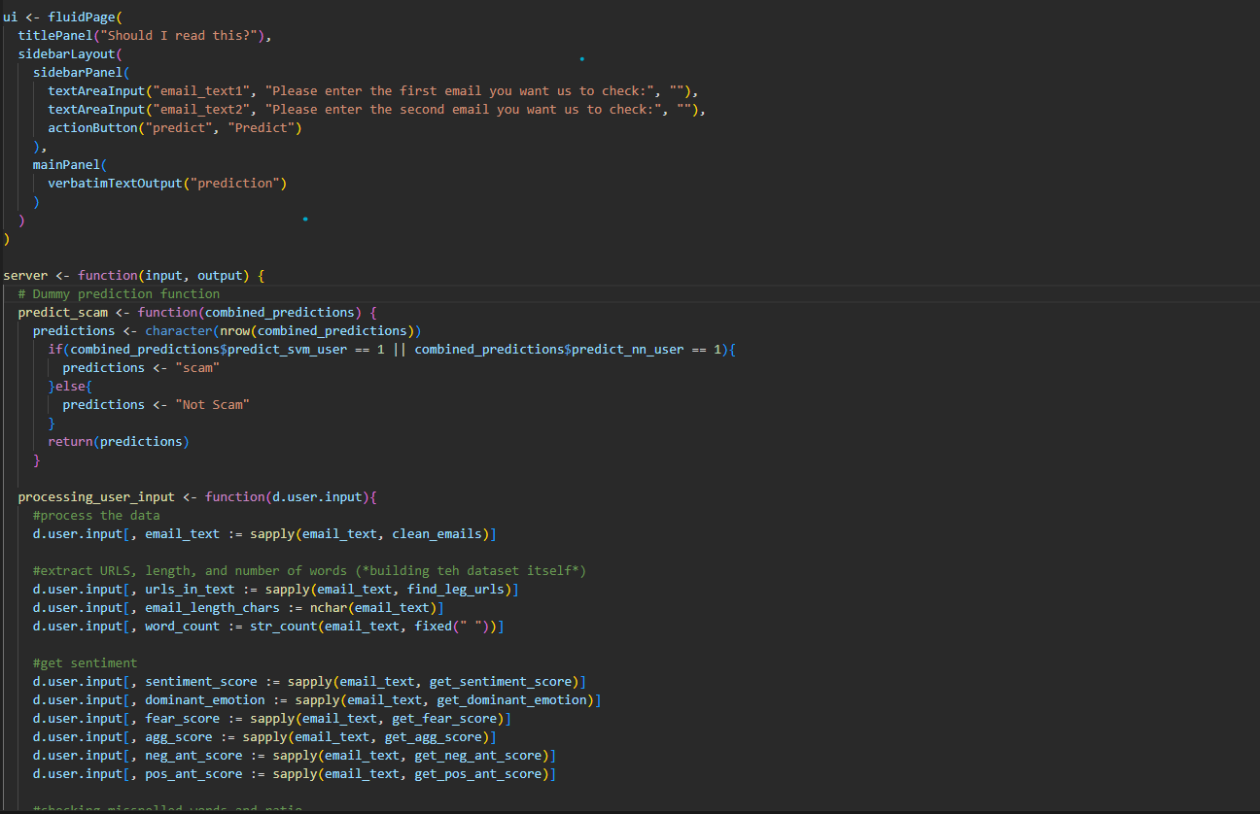
The Application Itself
Notes:
Uses shiny App, and includes all of the functions mentioned before. Keep it consistent even if it means copying and pasting code - very redundant

Slide 30
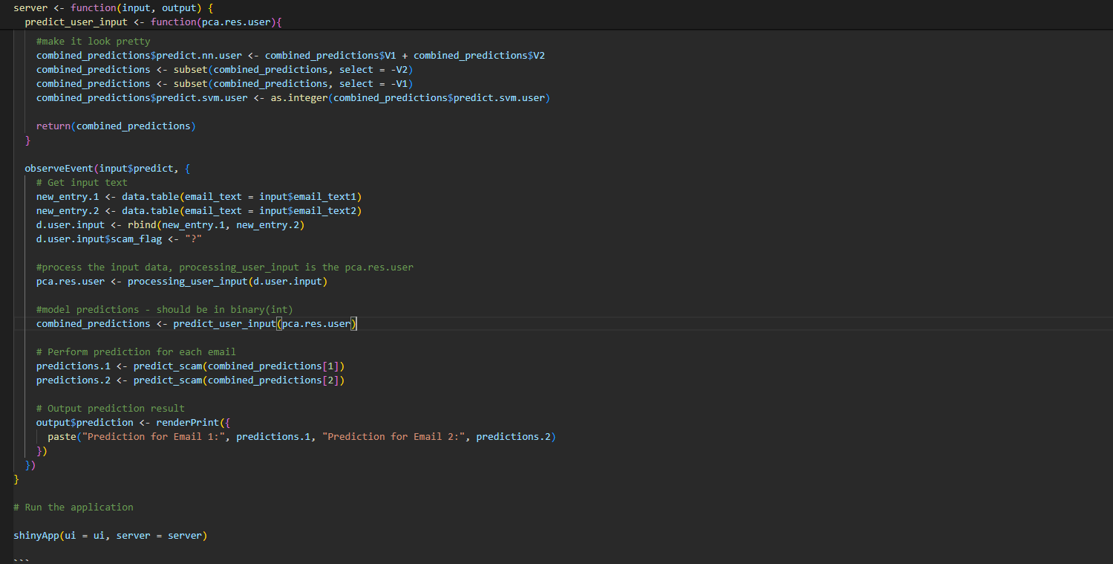
The Application Itself

Slide 31
Results

Slide 32
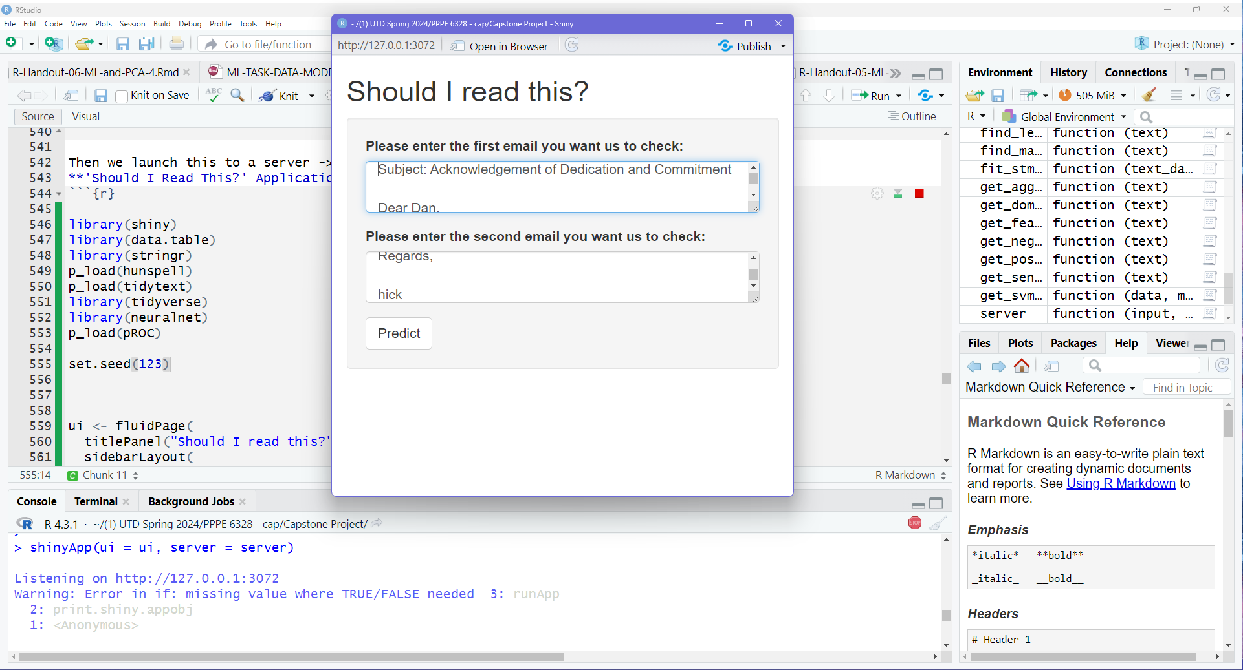

Slide 33
So, Why Doesn’t My App Work?
Errors needing to be debugged
It’s still incomplete
Logic needs to flow better
Return: the topic, sentiment/dominant emotion, and scam in terms of probability
Fix the need to take in 2 different emails
RStudio failing -> transition to Visual Basic
Working between the two
Constant reevaluating my models
Accuracy of models > having a bugging application
Seeking to understand the code, ML, etc.
Notes:
Caused me to back track to earlier phases of my code
Working bit by bit so I didn’t have to trace my steps because rstudio is kinda difficult to understand. The error messages the compiler sends back is often very confusion and it takes a lot of time to dissect
Learned I couldn’t rush this process -> lead me to more issues and trouble

Slide 34
Conclusion and Final Thoughts

Slide 35
What I Learned
Better time management
Key features: Misspelled ratio, emotion, and text
Scams often replicate a more positive tone, not necessarily fear or aggression
SVM vs. NN
Things I would adjust
Aggregate the data to focus on keywords/topics as opposed to dissecting the whole email
Simplify the code even further
Check to see if I need specific scores like aggression and fear involved in the data to make
Get the Application to run and provide emotion, summary/keywords, and probability of it being a scam
Notes:
Better time management: Always going to be a lot more errors and bugs to fix than you expect
First point on things I would adjust -> the reason i used the whole email_text was to provide context and bring more info to the data

Slide 36
Questions?

Slide 37
Thank
You!

Slide 38
References
Mazorra, B., Adan, V., & Daza, V. Do Not Rug on Me: Leveraging Machine Learning Techniques for Automated Scam Detection. Mathematics (Basel), 10(6). 949-973.
Mughaid, A., AlZu’bi, S., Hnaif, A., Taamneh, S., Alnajjar, A., & Elsoud, E.A. (2021). An Intelligent Cyber Security Phishing Detection System Using Deep learning. Techniques. Cluster Computing, 25(6). 3819-3828.
(2022). Federal Bureau of Investigation Elder Fraud Report. Internet Crime Complaint Center, 1-22.
https://github.com/mitchellkrogza/Phishing.Database?tab=readme-ov-file3
https://www.kaggle.com/datasets/sid321axn/malicious-urls-dataset
https://urlhaus.abuse.ch/api/
https://github.com/rmodi6/Email-Classification/tree/master
https://github.com/davidsvy/Neural-Scam-Artist/blob/master/generated_samples/generated_samples.txt
https://github.com/KalyanM45/Spam-Email-Detection/blob/main/Data%20Source/SPAM.csv
https://github.com/TanusreeSharma/phishingdata-Analysis/blob/master/1st%20data/PhishingEmailData.csv

